Slide 1
Get ready for Measles
ACCHS Clinic Checklist
Notes:
References:
https://www.racgp.org.au/running-a-practice/practice-management/managing-emergencies-and-pandemics/measles-fact-sheet-and-checklist
https://www.cdc.gov/measles/signs-symptoms/photos.html
https://dermnetnz.org/topics/measles
https://www.healthywa.wa.gov.au/Articles/J_M/Measles
https://www.health.wa.gov.au/Articles/J_M/Measles

Slide 2
Prepare for Measles
□ Stay up to date with WA exposure sites at: https://www.health.wa.gov.au/news/2025/perth-and-pilbara-measles-alert-july
Remember: MMR catch-up vaccination is free in Western Australia for those born after 1965. People need two doses of MMR to be fully protected.
Notes:
https://www.health.wa.gov.au/news/2025/perth-and-pilbara-measles-alert-july

Slide 3
Notes:
Posters available:
https://www.health.wa.gov.au/~/media/Files/Corporate/general-documents/Medical-notifications/PDF/Measles/Measles-poster---call-before-entering-or-use-mask.pdf
https://www.health.wa.gov.au/~/media/Files/Corporate/general-documents/Medical-notifications/PDF/Measles/Measles-poster---could-this-patient-have-measles---triage-for-EDs-GPs.pdf

Slide 4
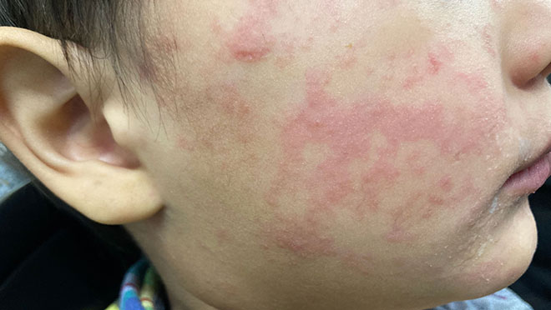
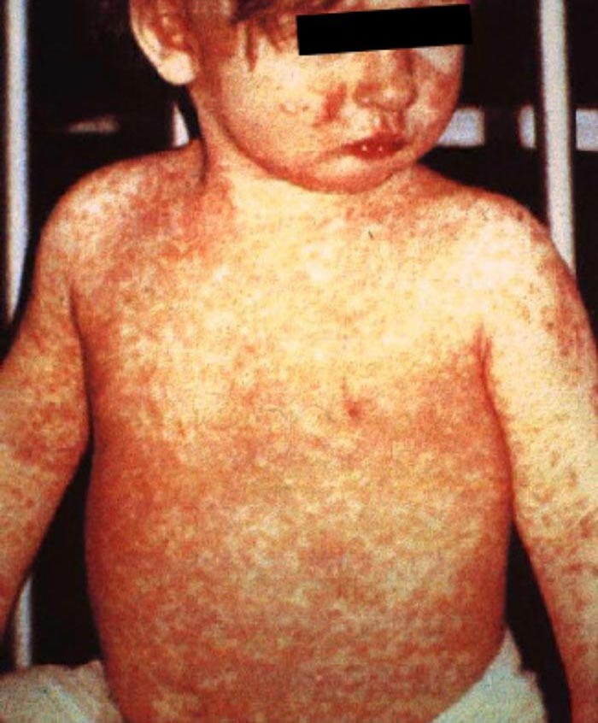
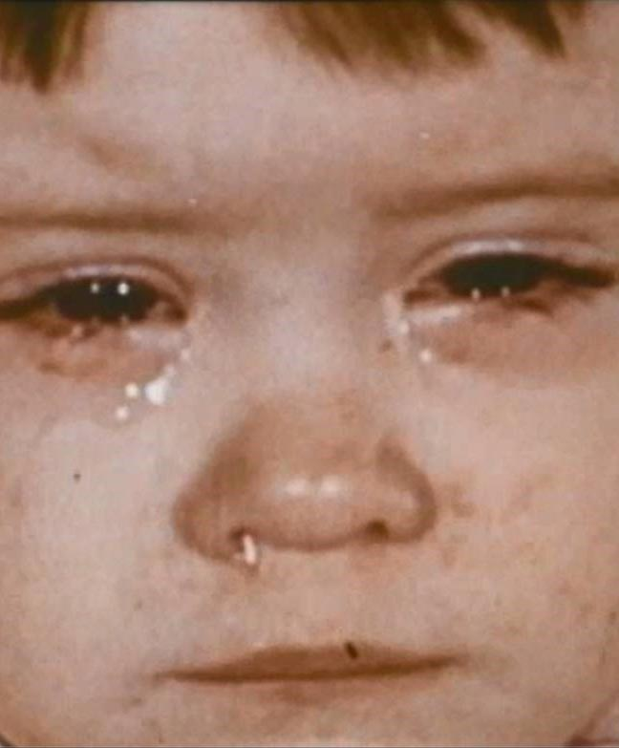
Measles: Signs and Symptoms
Initial symptoms:
Fever
Malaise (tiredness, weakness)
Dry cough
Runny nose
Sore, red eyes
Followed by: whole-of-body red blotchy rash (not itchy), beginning on the face and then spreading over trunk, arms and legs
Images: https://www.cdc.gov/measles/signs-symptoms/photos.html

Slide 5
Respond to Measles
Contact details for public health units, and the after hours Public Health Physician are available at: https://www.health.wa.gov.au/Articles/A_E/Contact-details-for-public-health-units

Slide 6
Notes:
Posters available:
https://www.safetyandquality.gov.au/publications-and-resources/resource-library/wa-2023-airborne-precautions
https://www.safetyandquality.gov.au/publications-and-resources/resource-library/wa-2023-standard-precautions

